Slide 1

PREDICTIVE ANALYTICS WITH MACHINE LEARNING FOR FRAUD DETECTION OF ONLINE MARKETING TRANSACTIONS
by
L.Narayana Reddy
Roll No. 204G1A0565
K.Pushpa
Roll No. 204G1A0574
G.Uday Kiran
Roll No. 204G1A05B4
N.Sai Harsha Vardhan
Roll No. 204G1A0585
Under the guidance of
Mrs. N.Usha Sree M.Tech
Associate Professor
Department of Computer Science and Engineering
Srinivasa Ramanujan Institute of Technology
(Autonomous)
2023 - 2024

Slide 2

Contents
Review-0 Comments
Abstract
Problem statement
Objectives of Project
Literature survey for first objective
Objective-1(Design & Implementation
Literature survey for second objective
Objective-2 (Design & Implementation)
Proposed Work -(Methods to be followed for proposed system)
References
GitHub Link
Queries

Slide 3
Abstract
With the surge in online transactions, there's a parallel increase in data leakage, fraud, and threats, causing substantial losses to customers. Hence, online marketing systems are urgently adopting advanced security and data handling technologies. Machine Learning (ML), Deep Learning (DL), and Predictive Analytics have emerged as potent solutions for managing sensitive data and preemptively identifying fraud and anomalous behaviors. These technologies efficiently analyze massive datasets, learn from historical patterns, and make accurate predictions, thus providing robust security to online transactions. Through continuous learning and adaptation, ML, DL, and Predictive Analytics significantly enhance the reliability and safety of online marketing systems, instilling confidence among users and stakeholders alike. Their implementation is imperative for safeguarding digital assets, personal data, and ensuring a secure and trustworthy online transaction environment.

Slide 4
Problem Statement
Current tools for real-time fraud detection in online marketing transactions lack user-friendliness and accessibility. There is a need for a web application that simplifies the process of inputting transaction data and obtaining instant fraud risk assessments, ensuring that businesses, even those without extensive technical knowledge, can efficiently protect themselves from online fraud.
Traditional fraud detection methods are often reactive and fail to adapt to emerging fraud patterns. To maintain a high level of fraud detection accuracy, businesses require a predictive analytics system capable of learning and adjusting to the latest fraud tactics. The challenge is to develop a predictive model that not only identifies known fraud patterns but also anticipates and counters new ones.

Slide 5
Objectives of Project
Develop a user-friendly web application that integrates machine learning models for real-time fraud detection in online marketing transactions. The application should allow users to input transaction data, and the system will provide immediate fraud risk assessment.
Train, deploy, and fine-tune machine learning models for predictive analytics in the detection of fraudulent online marketing transactions. Utilize historical transaction data and real-time monitoring to continuously improve the accuracy and efficiency of the fraud detection system.

Slide 6
Literature survey for first objective
S. NO | Journal Type with year | Authors | Title | Outcomes
1 | IEEE, 2020 | Taha, Altyeb & Malebary, Sharaf. | An Intelligent Approach to Credit Card Fraud Detection Using an Optimized Light Gradient Boosting Machine | Fundamentals of Boosting Techniques.
2 | IEEE .(2019). | Assaghir, Zainab & Taher, Yehia & Haque, Rafiqul | An Experimental Study With Imbalanced Classification Approaches for Credit Card Fraud Detection | Basics of Imbalanced Data Treatment.

Slide 7
Design and Implementation of Second objective
Fig 1 : Use case Diagram

Slide 8
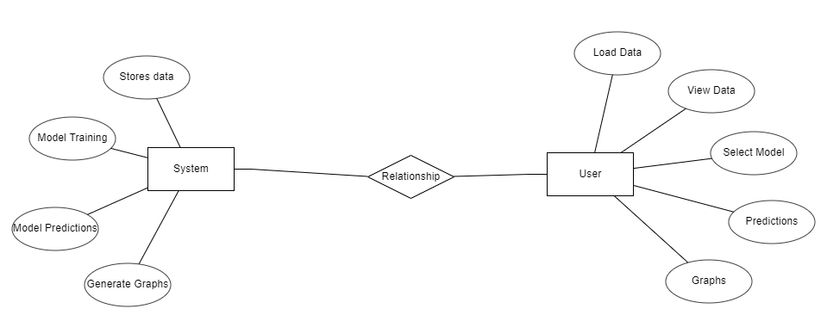
Design and Implementation of Second objective
Fig 2 : ER Diagram

Slide 9

Design and implementation of Second objective
@app.route('/’)
def home():
return render_template('index.html')

Slide 10
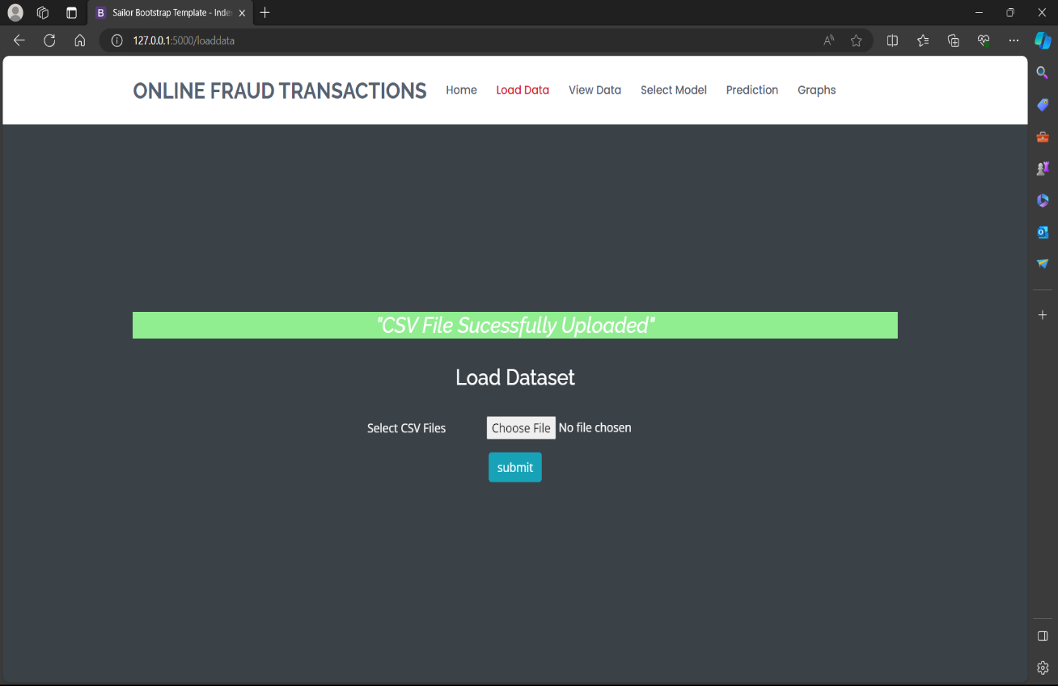
Design and Implementation of Second objective
@app.route('/loaddata',methods = ['POST','GET’])
def load_data():
if request.method == 'POST':
file = request.files['file’]
filetype = os.path.splitext(file.filename)[1]
print(filetype)
if filetype == '.csv’:
path = os.path.join(app.config['upload folder’],file.filename)
file.save(path)
print(path)
return render_template('load data.html',msg = 'success')
else:
return render_template('load data.html',msg = 'invalid’)
return render_template('load data.html')

Slide 11
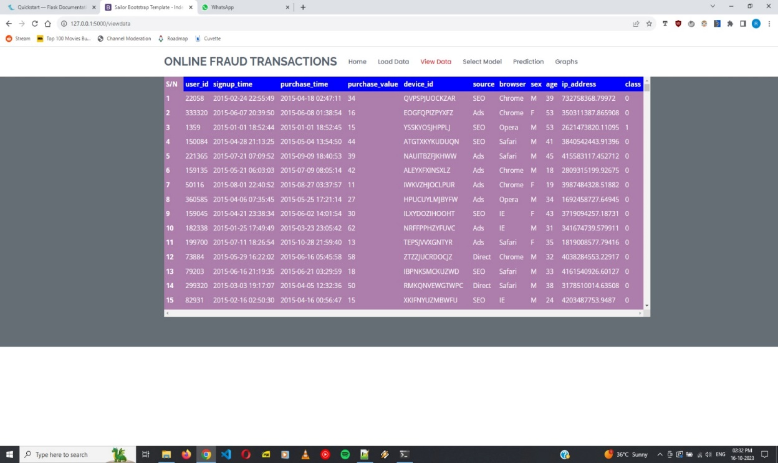
Design and Implementation of Second objective
@app.route('/viewdata’)
def view_data():
global df
file = os.listdir(app.config['upload folder’])
path = os.path.join(app.config['upload folder'],file[0])
df = pd.read_csv(path)
print(df)
return render_template('view data.html',col_name = df.columns,row_val = list(df[:1000].values.tolist()))

Slide 12
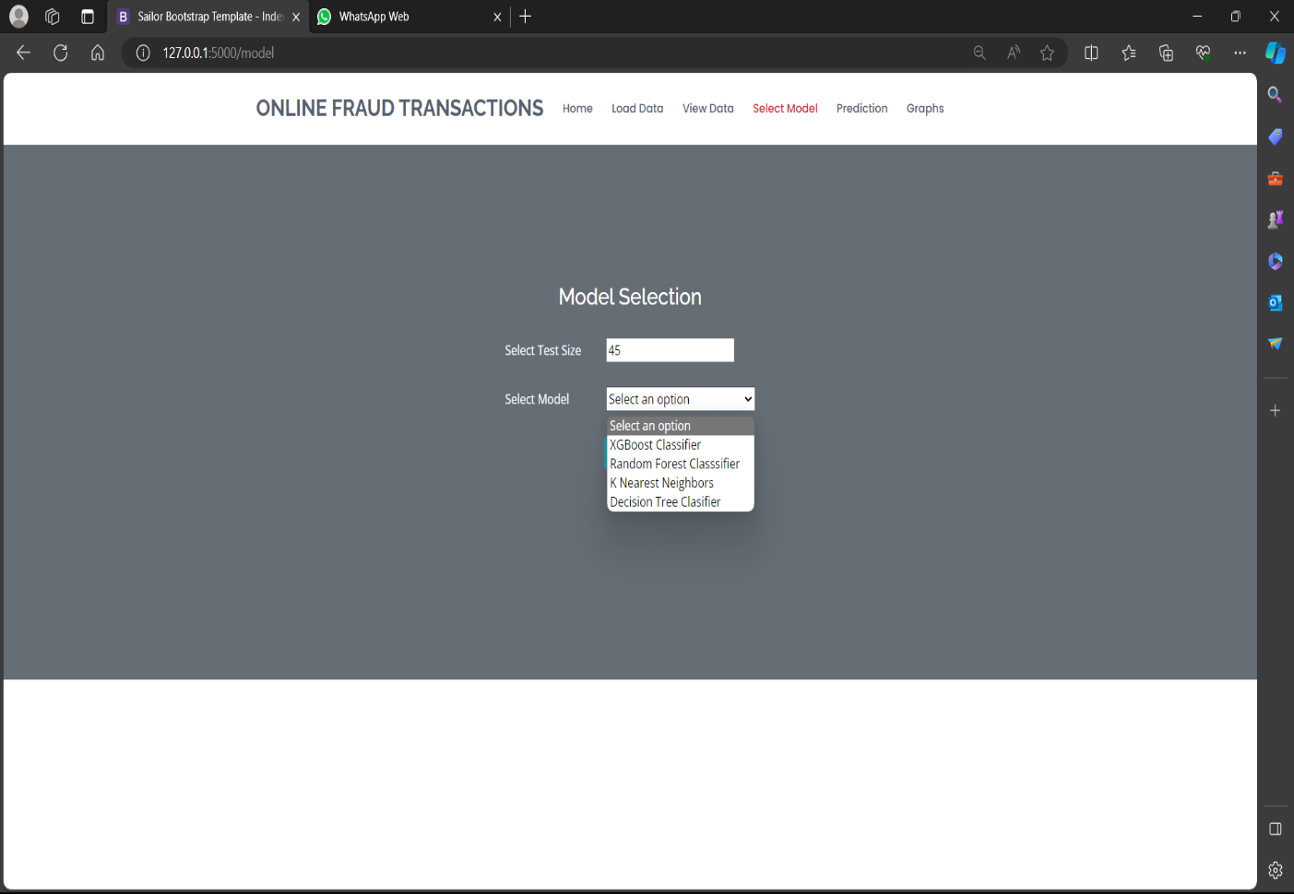
Design and Implementation of Second objective
@app.route('/model',methods = ["POST","GET"])
def model():
if request.method == "POST":
global x_train,y_train,x_test,y_test
global score1,score11,score111,score2,score22,score222
global score3,score33,score333,score4,score44,score444
model = int(request.form['selected’])
print(model)
test = int(request.form['testsize'])
testsize = test/100
data = df
print(data)
cat = data.select_dtypes(include= ‘object’)
num = data.select_dtypes(exclude = 'object’)
le = LabelEncoder()
cat_enc = cat.apply(le.fit_transform)
data1 = pd.concat([cat_enc,num],axis = 1)
print(data1)

Slide 13
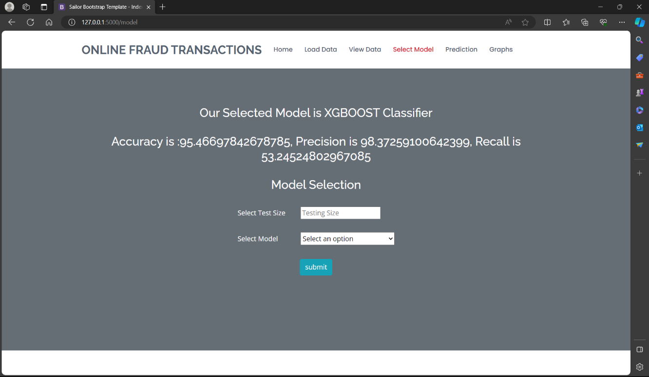
Design and Implementation of Second objective
X = data1.drop(['user_id','class'],axis = 1)
y = data1['class’]
x_train,x_test,y_train,y_test = train_test_split
(X,y,test_size=testsize,random_state=10)
if model == 1:
model1 = xgb.XGBClassifier()
model1.fit(x_train,y_train)
pred1 = model1.predict(x_test)
score1 = accuracy_score(y_test,pred1)
score11 = precision_score(y_test,pred1)
score111 = recall_score(y_test,pred1)
return render_template('model.html',msg = 'accuracy',acc =score1,rec = score111,pre = score11,selected = 'XGBOOST Classifier')

Slide 14
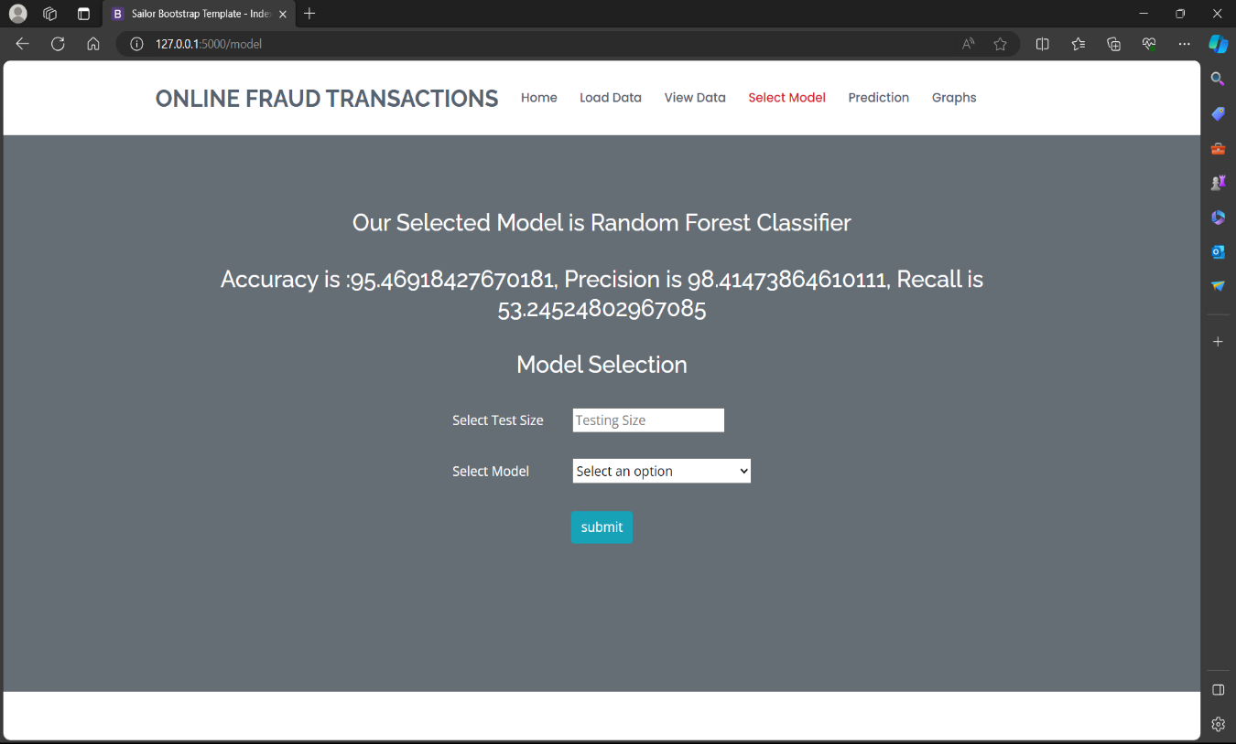
Design and Implementation of Second objective
elif model == 2:
model2 = RandomForestClassifier()
model2.fit(x_train,y_train)
pred2 = model2.predict(x_test)
score2 = accuracy_score(y_test,pred2)
score22 = precision_score(y_test,pred2)
score222 = recall_score(y_test,pred2)
return render_template('model.html',msg = 'accuracy',acc =score2,rec = score222,pre = score22,selected = ' Random Forest Classifier')

Slide 15
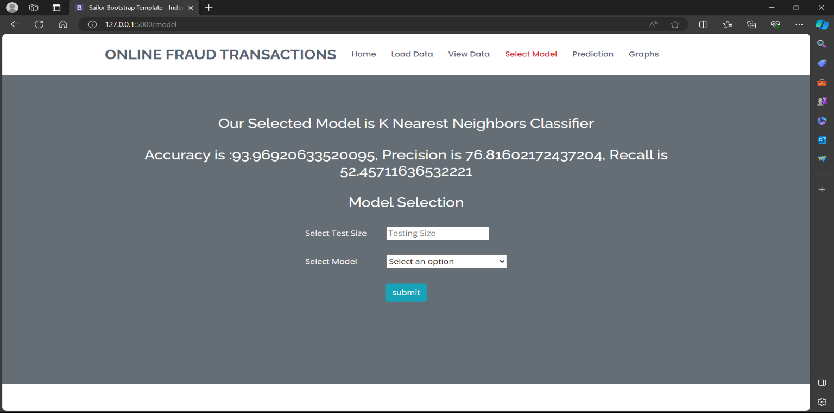
Design and Implementation of Second objective
elif model == 3:
model3 = KNeighborsClassifier()
model3.fit(x_train,y_train)
pred3 = model3.predict(x_test)
score3 = accuracy_score(y_test,pred3)
score33 = precision_score(y_test,pred3)
score333 = recall_score(y_test,pred3)
return render_template('model.html',msg = 'accuracy',acc =score3,rec = score333,pre = score33,selected = 'K Nearest Neighbors Classifier')

Slide 16

Design and Implementation of Second objective
elif model == 4:
model4 = DecisionTreeClassifier()
model4.fit(x_train,y_train)
pred4 = model4.predict(x_test)
score4 = accuracy_score(y_test,pred4)
score44 = precision_score(y_test,pred4)
score444 = recall_score(y_test,pred4)
return render_template('model.html',msg = 'accuracy',acc =score4,rec = score444,pre = score44,selected = 'Decisison Tree Classifier') return render_template('model.html')

Slide 17
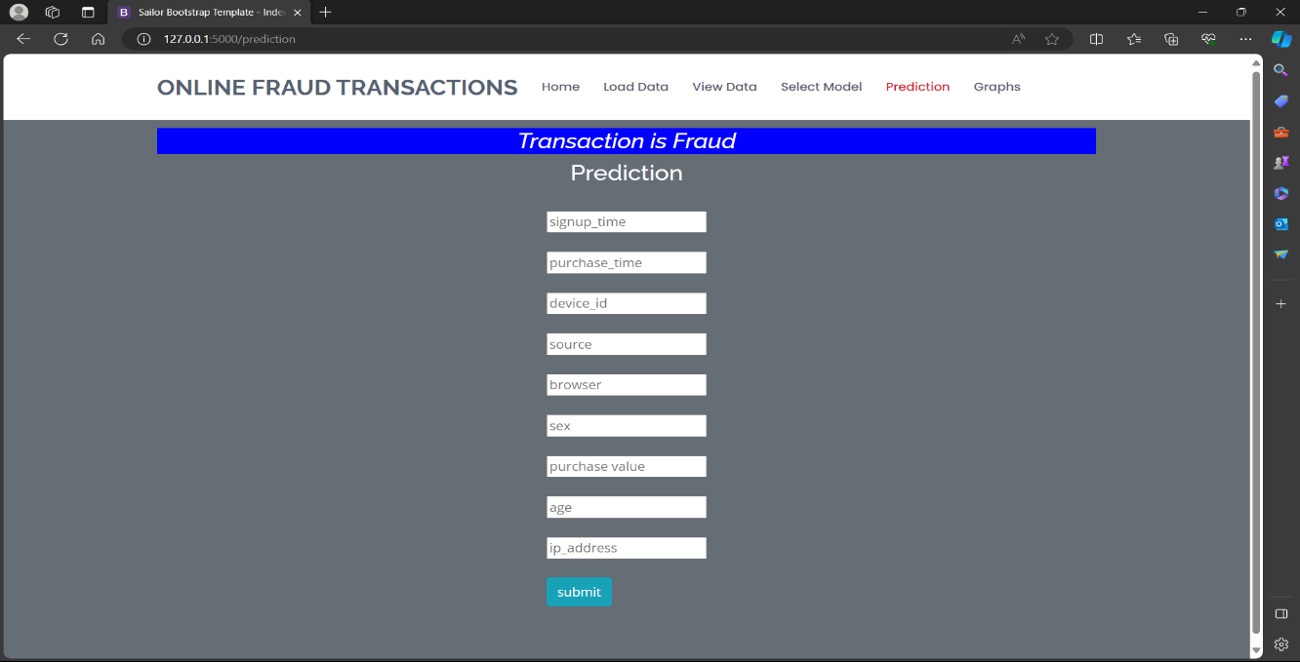
Design and Implementation of Second objective
@app.route('/prediction',methods = ["POST","GET"])
def prediction():
if request.method == "POST":
a = int(request.form['a’])
b = int(request.form['b’])
c = int(request.form['c'])
d = int(request.form['d’])
e = int(request.form['e'])
f = int(request.form['f'])
g = int(request.form['g’])
h = int(request.form['h'])
i = float(request.form['i’])
val = [int(a),int(b),int(c),int(d),int(e),int(f),int(g),int(h),float(i)]
model2 = RandomForestClassifier()
model2.fit(x_train, y_train)
# le =LabelEncoder()
# ex = le.fit_transform(val)
print(val)
pred = model2.predict([val])
print(pred)
# results = le.inverse_transform(pred)
# print(results)
return render_template('prediction.html',msg = 'success',result = pred)
return render_template('prediction.html')

Slide 18
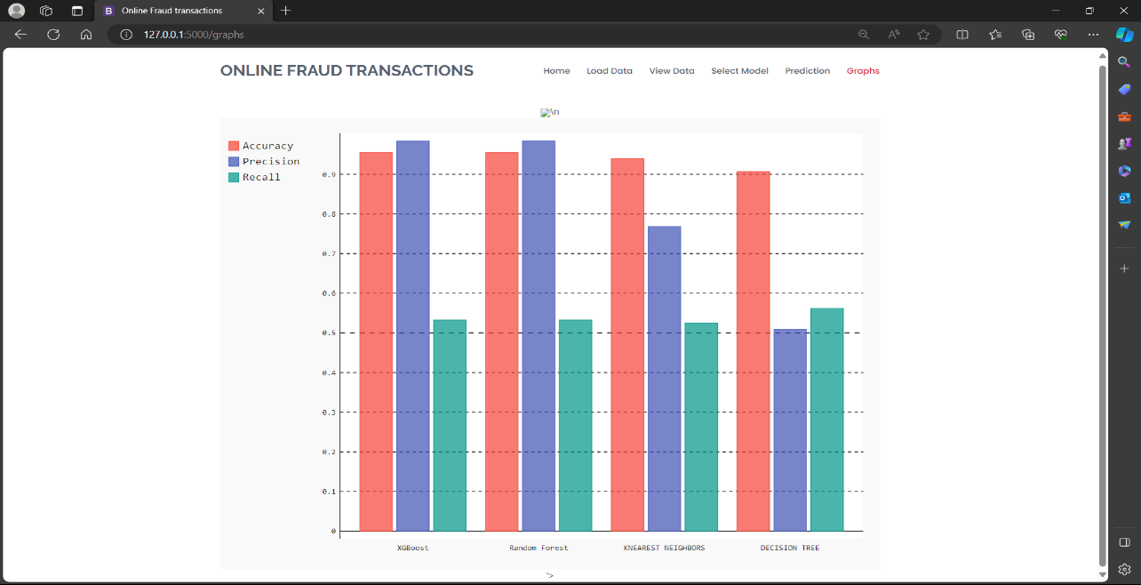
Design and Implementation of Second objective
@app.route('/graphs',methods = ['POST',"GET"])
def graphs():
# line_chart = pygal.bar()
print('jhdbhsgd’)
line_chart = pygal.Bar()
line_chart.x_labels= ['XGBoost','Random Forest’,
'KNEAREST NEIGHBORS','DECISION TREE']
print('jdjkfdf’)
line_chart.add('Accuracy' ,[score1,score2,score3,score4])
print('1’)
line_chart.add('Precision' ,[score11,score22,score33,score44])
print('2’)
line_chart.add('Recall' ,[score111,score222,score333,score444])
print('3’)
graph_data = line_chart.render()
print(graph_data)
print(type(graph_data))
return render_template('graphs.html',graph_data = graph_data)
if _name_ == '_main_':
app.run(debug=True)

Slide 19
Literature survey for second objective
S. NO | Journal Type with year | Authors | Title | Outcomes
3 | IJRASET, (2021) | A Sampath Abhishek | Predictive Analytics with Machine Learning for Fraud Detection | Random Forest.
4 | Information Sciences, Elsevier (2019), | F. Carcillo, Y.-A. Le Borgne and O. Caelen et al | Combining unsupervised and supervised learning in credit card fraud detection | Fundamentals of Machine Learning.

Slide 20
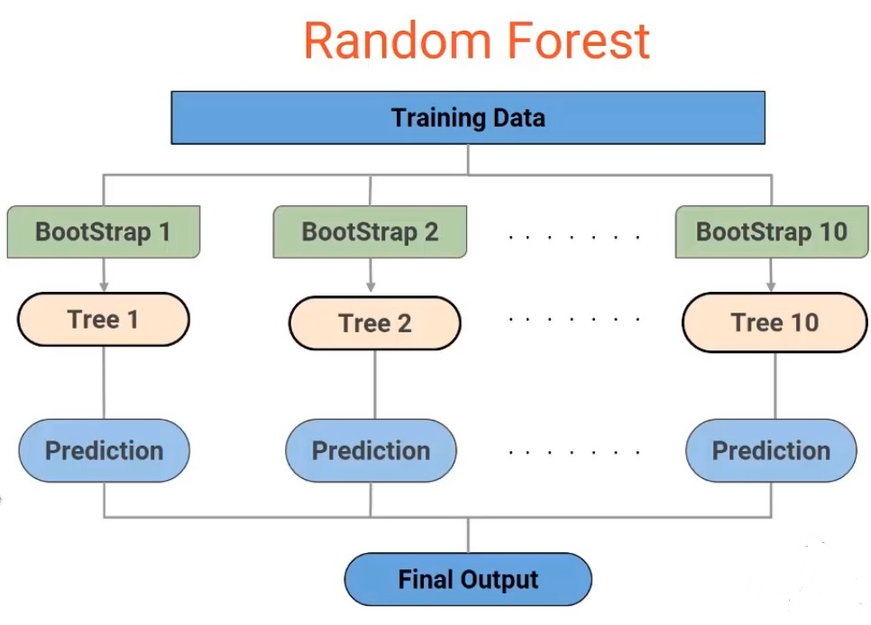
Design and implementation of second objective

Slide 21
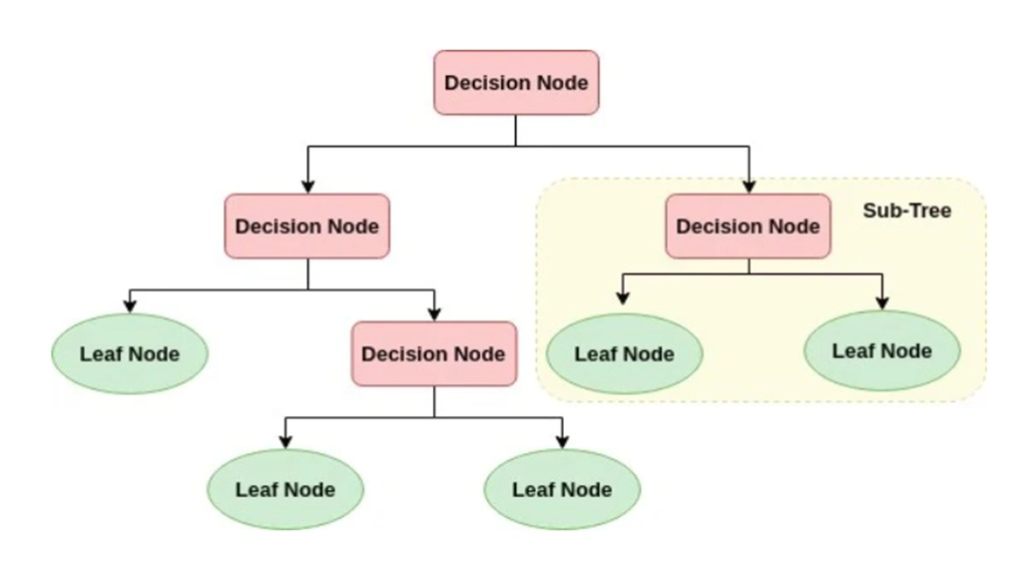
Design and implementation of second objective

Slide 22
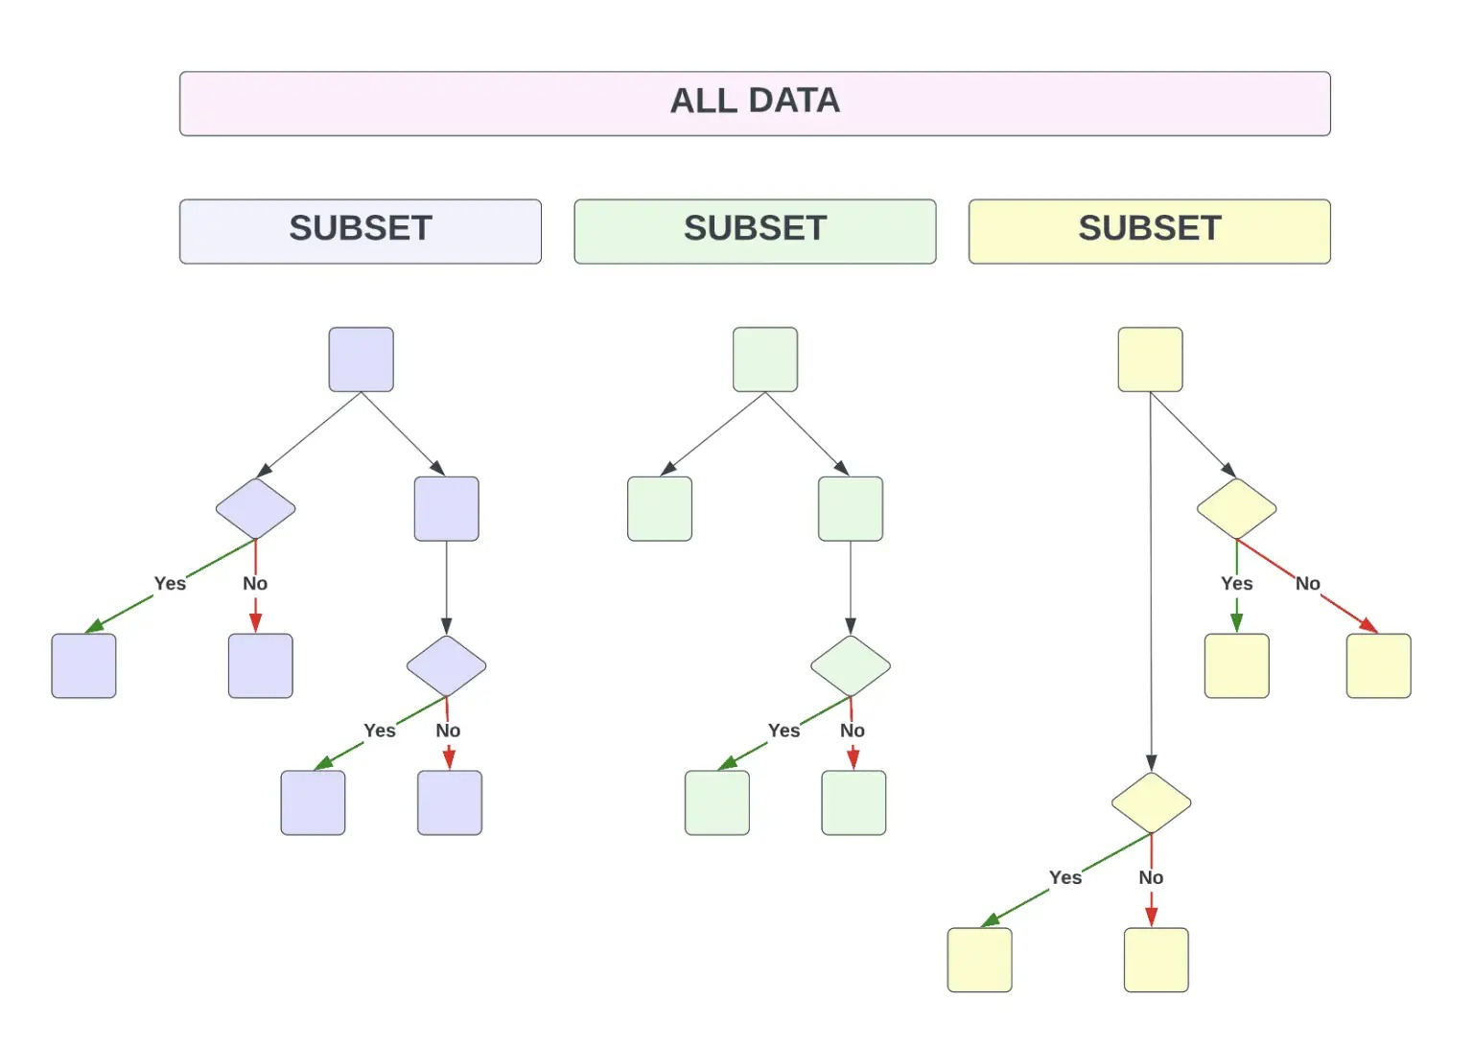
Design and implementation of second objective

Slide 23
Proposed System
We propose this system to investigate a problem of whether it is valuable or not to use machine learning techniques to detect whether the credit card is fraud or not fraud using Decision Trees, KNN Classifier, Random Forest Algorithm.

Slide 24
References
[1].IEEE, 2020Taha, Altyeb & Malebary, Sharaf. “An Intelligent Approach to Credit Card Fraud Detection Using an Optimized Light GradientBoosting Machine Fundamentals of Boosting Techniques”.
[2]. IEEE .(2019).Assaghir, Zainab & Taher, Yehia & Haque, Rafiqul "An Experimental Study With Imbalanced Classification Approaches for Credit Card Fraud Detection Basics of Imbalanced Data Treatment”.
[3]. IJRASET, (2021), A Sampath Abhishek, “Predictive Analytics with Machine Learning For Fraud Detection”.

Slide 25
References
[4]. Information Sciences, Elsevier (2019), F. Carcillo, Y.-A. Le Borgne and O. Caelen et al, “Combining unsupervised and supervised learning in credit card fraud detection Fundamentals of Machine Learning”.

Slide 26
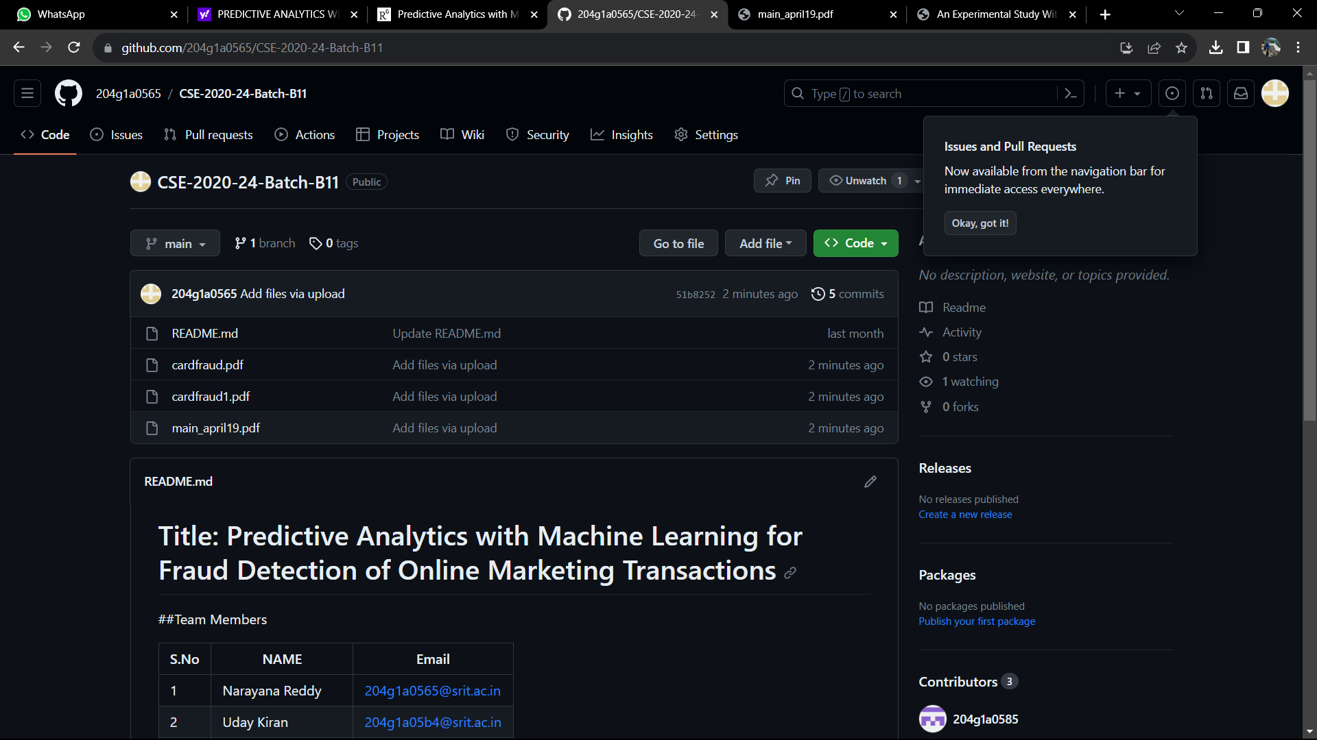
Git Hub Dashboards of each student
GitHub Link :https://github.com/204g1a0565/CSE-2020-24-Batch-B11

Slide 27
Any Queries?

